Slide 1



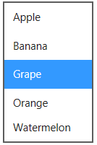

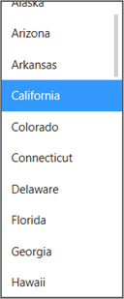
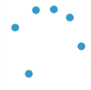
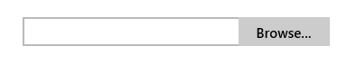
HTML Controls (standard markup; default light styles)
Button (<button> <input type="button">)
Hyperlink (<a href>, <link>)
Slider (<input type="range">)
ListBox (<select>)
Checkbox (<input type=“checkbox">)
Progress Bar (<progress>)
Combo Box (<select>)
Progress Ring (<progress>)
File Upload (<input type=“file">)
Radio Button (<input type=“radiobutton">)
Again, layout-related elements in Chapter 5, media in Chapter <TODO> (img, canvas, svg, audio, video)

Slide 2
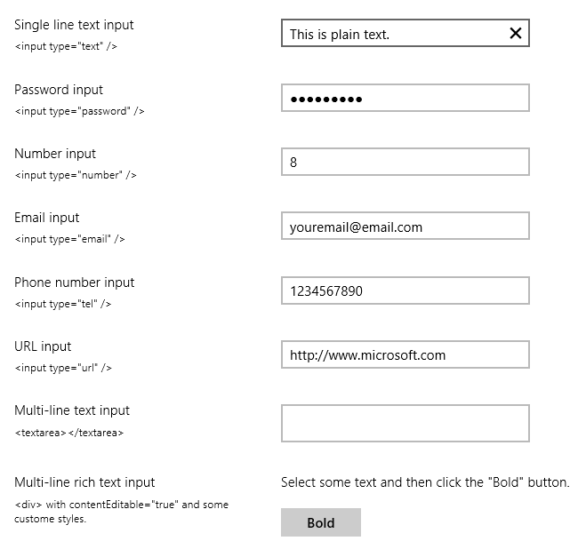

HTML Controls (standard markup), cont.
Clear Button
(shows when entering text; change event fires when pressed).
Single-line text (<input>; all HTML5 types are supported)
Reveal Button <update this>
Multi-line text (<textarea>)
Rich text (<div>)

Slide 3



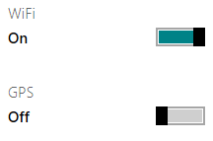

WinJS Controls (<div data-win-control=“[class]”>)
DatePicker
TimePicker
Ratings
ToggleSwitch
PageControl (renders any piece of HTML+ CSS+JS defined with WinJS.UI.Pages)
Tooltip (automatic on HTML elements with title attribute)
HtmlControl (an alias for simple uses of a PageControl)
Collection controls (FlipView, ListView) in Chapter 4; non-layout UI elements in Chapter <TODO>

Slide 4
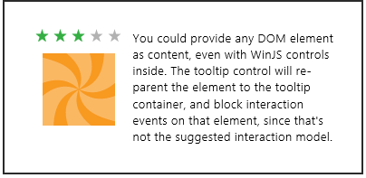
Tooltip Control Example
Can either attach to an element, or put element inside the control
<span data-win-control="WinJS.UI.Tooltip"> <!-- The element that gets the tooltip goes here. --> </span> <div data-win-control="WinJS.UI.Tooltip"> <!-- The element that gets the tooltip goes here. --> </div>
<!-- You can also directly attach the Tooltip to its target element. --> <targetElement data-win-control="WinJS.UI.Tooltip"> </targetElement>
<div data-win-control="WinJS.UI.Tooltip" data-win-options="{infotip: true, contentElement: myContentElement}">
<span>My piece of data</span>
</div>
<div style="display: none;">
<!--Here is the content element. It's put inside a hidden container so that it's invisible to the user until the tooltip takes it out.-->
<div id="myContentElement">
<div id="myContentElement_rating">
<div data-win-control="WinJS.UI.Rating“ class="win-small movieRating“ data-win-options="{userRating: 3}"> </div>
</div>
<div id="myContentElement_description">
<p>You could provide any DOM element as content, even with WinJS controls inside. The tooltip control will re-parent the element to the tooltip container, and block interaction events on that element, since that's not the suggested interaction model.</p>
</div>
<div id="myContentElement_picture">
</div>
</div>
</div>
contentElement property can name another element for the tooltip

Slide 5

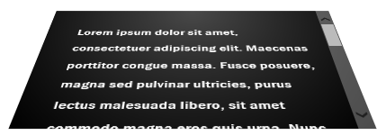
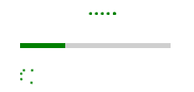
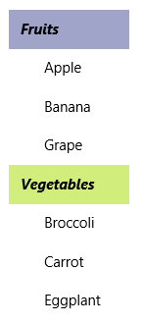

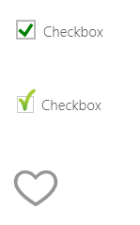

Examples of Applying Standard CSS
Button (background-color)
Text Area (transform)
Progress (color)
Select (background-color, color, border, font)
Checkbox/Radiobutton (background-image and :checked)

Slide 6


Special HTML Control Styling Run-down
Drawing from the Controls_EverydayWidgets sample
Button
<button class="win-backbutton">
Checkbox/Radiobutton
CSS pseudo-element: input[type="checkbox"].<class>::-ms-check (color)
CSS pseudo-element: input[type="checkbox"].<class>::-ms-check (image)
CSS pseudo-element: input[type="radio"].<class>::-ms-check (color)

Slide 7




Special HTML Control Styling Run-down (cont)
Drawing from the Controls_EverydayWidgets sample
File upload
Text Input (most forms)
CSS pseudo-element: input[type="file"].<class>::-ms-value
CSS pseudo-element: input[type="<type>"].<class>::-ms-value CSS pseudo-class: input[type="<type>"].<class>:-ms-input-placeholder
CSS pseudo-element: input[type="file"].<class>::-ms-browse
CSS background image (and other styles)
CSS pseudo-element: input[type="<type>"].<class>::-ms-clear
Progress
Text Input (password)
CSS pseudo-element: progress.<class>::-ms-fill { -ms-animation-name: -ms-ring; }
CSS pseudo-element: input[type="password"].<class>::-ms-reveal
CSS pseudo-element: progress.<class>::-ms-fill (background-image, etc)

Slide 8



Special HTML Control Styling Run-down (cont)
Drawing from the Controls_EverydayWidgets sample
Range/Slider (<input type="range">)
::-ms-tooltip { display:none; } (only recognized style)
CSS pseudo-elements on input[type="range"].<class>
::-ms-ticks-before (top side) ::-ms-track (track area incl. ticks) ::-ms-ticks-after (bottom side)
::-ms-fill-lower
::-ms-fill-upper
::-ms-thumb
<input type="range" class="win-vertical">
::-ms-fill-lower (background-image)
::-ms-fill-upper (background-image)
::-ms-thumb
Default tooltip (visible)
(All else is standard CSS e.g. border-radius)
::-ms-track (color and background-color set to transparent)
::-ms-thumb (background image)

Slide 9
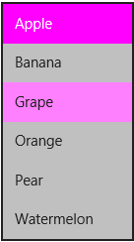
Special HTML Control Styling Run-down (cont)
Drawing from the Controls_EverydayWidgets sample
Combo/list box (<select>)
CSS pseudo-element: select.<class>::-ms-value
Styling on select.<class> option:hover
CSS pseudo-element: select.<class>::-ms-expand

Slide 10

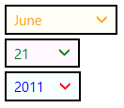
WinJS Date/TimePicker Styling
Modifications to “HTML DatePicker and TimePicker controls sample”
win-timepicker and win-datepicker style the whole control (you override defaults)
win-datepicker-* style individual parts (display: none will hide that part)
win-orderN identifies the sub-element by position
Style { display: block; float: none } on children for vertical layout
.win-datepicker .win-datepicker-year {
color: blue;
}
.win-datepicker .win-datepicker-date {
color: green;
}
.win-datepicker .win-datepicker-month {
color: orange;
}
.win-datepicker .win-datepicker-year::-ms-expand {
color: red;
}
.win-datepicker .win-order0 {
background-color: rgb(255, 255, 248);
}
.win-datepicker .win-order1 {
background-color: rgb(255, 248, 255);
}
.win-datepicker .win-order2 {
background-color: rgb(248, 255, 255);
}
win-datepicker-day
win-datepicker-month
win-datepicker-year
win-order0
win-order1
win-order2
.win-datepicker [class^="win-datepicker"] {
display: block;
float: none;
}
Notes:
Include patterns for the options, e.g.
data-win-control="WinJS.UI.DatePicker" data-win-options="{monthPattern: 'month.full'}"

Slide 11
WinJS Date/TimePicker Styling
Modifications to “HTML DatePicker and TimePicker controls sample”
win-timepicker-minute
win-timepicker-hour
win-timepicker-period
win-order0
win-order1
win-order2

Slide 12
WinJS Rating Control Styling
See “HTML Rating control sample”
Rating control has states in addition to the its stars and the overall control
win-* classes identify these individually; combinations style all the variations
Style Class | State
win-average | Control is displaying the average rating (user has not selected a rating).
win-disabled | Control is disabled.
win-tentative | Control is displaying a tentative rating.
win-user | Control is displaying user-chosen rating.
Style Class | Part
win-rating | Styles the entire control.
win-star | Styles the control's stars generally.
win-empty | Styles the control's empty stars.
win-full | Styles the control's full stars.
Variation | Classes (selectors)
Average empty stars | .win-star.win-average.win-empty
Average full stars | .win-star.win-average.win-full
Disabled empty stars | .win-star.win-disabled.win-empty
Disabled full stars | .win-star.win-disabled.win-full
Tentative empty stars | .win-star.win-tentative.win-empty
Tentative full stars | .win-star.win-tentative.win-full
User empty stars | .win-star.win-user.win-empty
User full stars | .win-star.win-user.win-full

Slide 13



WinJS Rating Control Styling (examples)
From “HTML Rating control sample”
.win-rating .win-star.win-user.win-full (colors)
.win-rating .win-star (font size)
class="win-small"
.win-rating .win-star (background image)

Slide 14
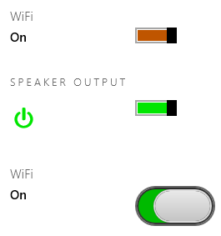
WinJS Toggle Switch Styling
From “HTML ToggleSwitch control sample”
win-* classes identifies parts of the control (states are implicit)
win-title
win-label-on
win-label (both)
win-label-off
win-switch a slider control, so all pseudo-elements for parts apply, like ::-ms-thumb, ::-ms-track, ::-ms-fill-lower, & ::-ms-fill-upper, e.g.:

Slide 15
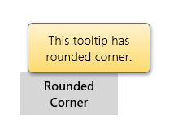
WinJS Tooltip Control Styling
From “HTML Tooltip control sample”
win-tooltip is single class for entire control (such as border)
Control can contain any other HTML, to which other CSS applies
#roundedCornerTooltip {
border-radius: 6px;
max-width: 140px;
padding: 10px;
border: 1px solid rgb(108, 108, 108);
background-image:
-ms-linear-gradient(-90deg, rgb(255, 242, 207),
rgb(254, 218, 108));
box-shadow: 1px 2px 6px rgba(0, 0, 0, 0.4);
text-align: center;
}

Slide 16
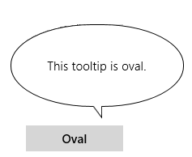
WinJS Tooltip Control Styling
#ovalTooltip {
display: -ms-box;
-ms-box-orient: vertical;
-ms-box-align: middle;
}
#oval {
border-radius: 100px 100px 100px 100px / 50px 50px 50px 50px;
width: 212px;
height: 100px;
border: 1px solid black;
background-color: white;
text-align: center;
line-height: 100px;
color: black;
}
#beak {
background-image: url("images/beak.svg");
background-repeat: no-repeat;
background-size: 100% 100%;
width: 12px;
height: 16px;
margin-top: -1px;
}

Slide 17



WinJS BackButton Styling
win-navigation-backbutton applies to the <button>
win-back applies to the <span> with the circle and arrow
.win-back {
border-color: rgb(255, 106, 0); /* Circle color */
color: rgb(255, 106, 0); /* Arrow color */
}
.win-navigation-backbutton:hover .win-back {
background-color: rgba(255, 106, 0, 0.25);
border-color: rgb(255, 106, 0);
color: rgb(255, 106, 0);
}
.win-navigation-backbutton:hover:active .win-back,
.win-navigation-backbutton:active .win-back {
background-color: rgb(128, 53, 0);
border-color: rgb(128, 53, 0);
color: rgb(255, 255, 255);
}

Slide 18

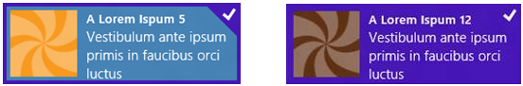
ItemContainer Layers
<!-- Markup in your HTML file -->
<div class="[your classes]" data-win-control="WinJS.UI.ItemContainer">
[your item content]
</div>
<!-- Results in the DOM -->
<div class="win-container [your classes]">
<div class="win-itembox">
<div class="win-item">
[your item content]
win-selectionstyleoutline
win-selectionstylefilled

Slide 19






ItemContainer Styling
.win-container {
border: dotted 6px orange;
}
.win-focusedoutline {
outline: black dashed 1px;
}
.win-container:hover {
outline: rgba(0, 0, 255, 0.4) dotted 6px;
}

Slide 20
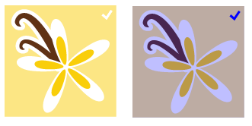
ItemContainer Styling
.win-container.win-selectionstylefilled.win-selected .win-selectionborder {
background-color: rgba(0, 0, 255, .25);
}
.win-container.win-selectionstylefilled .win-selectioncheckmark {
color: blue;
}

Slide 21

ItemContainer Styling
.win-container:not(.win-selectionstylefilled).win-selected .win-selectionborder {
border-color: yellow;
}
.win-container:not(.win-selectionstylefilled).win-selected .win-selectioncheckmarkbackground {
border-top-color: yellow;
border-right-color: yellow;
border-left-color: yellow;
border-bottom-color: yellow;
border-width: 25px;
border-radius: 50px;
margin: 5px;
}
.win-container:not(.win-selectionstylefilled) .win-selectioncheckmark {
font-size: 0px; /* Hide the default checkmark */
margin-right: 12px;
margin-top: 10px;
}
.win-container:not(.win-selectionstylefilled) .win-selectioncheckmark::before {
content: '\E0A5';
font-size: 30px;
color: red;
}

Slide 22
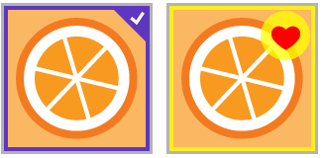
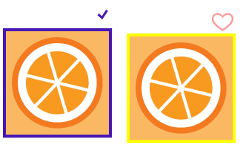
ItemContainer Styling
.win-container:not(.win-selectionstylefilled).win-selected:hover .win-selectionborder,
.win-container:not(.win-selectionstylefilled).win-selected:hover .win-selectioncheckmarkbackground {
border-color: rgba(255, 255, 0, 0.75);
}
.win-container:not(.win-selectionstylefilled) .win-selectionhint {
font-size: 0px; /* Hide the default checkmark */
}
.win-container:not(.win-selectionstylefilled) .win-selectionhint::before {
content: '\E006';
font-size: 30px;
color: rgba(255, 0, 0, 0.4);
}

Slide 23

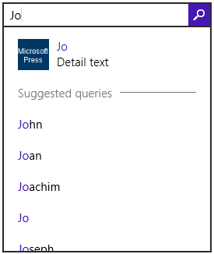
SearchBox
win-searchbox (whole control) also win-searchbox-disabled
win-searchbox-input win-searchbox-input-focus
win-searchbox-button win-searchbox-button-input-focus
win-searchbox-flyout

Slide 24

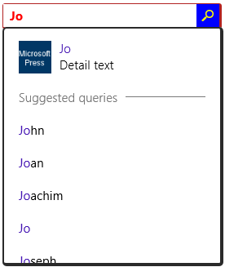
SearchBox Styling
.win-searchbox input[type]:-ms-input-placeholder {
color: rgba(255, 0, 0, 0.6);
}
.win-searchbox input[type] {
color: red;
font-weight: 700;
}
.win-searchbox {
margin-left: 10px;
border-style: solid;
border-color: firebrick;
border-width: 1px 3px 3px 1px;
border-radius: 3px;
}
.win-searchbox-flyout {
border-width: 2px 4px 4px 2px;
border-radius: 5px;
}
.win-searchbox-button {
background-color: blue;
color: yellow;
}

Slide 25
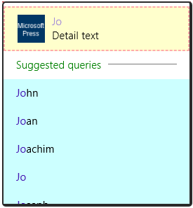
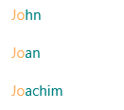
SearchBox
win-searchbox-flyout-highlighttext
win-searchbox-suggestion-result-text
win-searchbox-suggestion-result-detailed-text
win-searchbox-hithighlight-span
.win-searchbox-suggestion-separator hr {
border-style: dotted;
border-color: purple;
border-width: 8px 0px 0px 0px;
}
.win-searchbox-suggestion-result {
border: dashed 2px #faa;
}
.win-searchbox-suggestion-selected {
background-color: #ffc;
}
.win-searchbox-suggestion-separator {
color: green;
}
.win-searchbox-suggestion-query {
background-color: #cff;
}
.win-searchbox-hithighlight-span {
color: teal;
}
.win-searchbox-flyout-highlighttext {
color: #fa5;
}

Slide 26

SearchBox
.win-searchbox-suggestion-result div {
border: solid 1px #800;
}
.win-searchbox-suggestion-result-text {
font-weight: 700;
}
.win-searchbox-suggestion-result-detailed-text {
font-style: italic;
}
.win-searchbox-suggestion-result img {
border: dotted 4px pink;
}

Slide 27
Data Binding
General idea:
There are properties of objects and properties of UI elements
We want to connect or “bind” these together, possibly with initializers/converters in between, so that UI reflects the object values (and possibly vice-versa).
Multiple elements can be bound to the same object, or one element bound to multiple objects
<span>
innerText
style.color
Source
name
id
photoURL
userType
Direct bind: set innerText equal to value of name
Direct bind: set src equal to value of photoURL
<img>
src
Converter
Conversion: set style.color equal to the output of the converter function given for userType

